Slide 1
CONTINUATION OF WATER REQUIREMENTS AND AVAILABILITY RECONCILIATION STRATEGY FOR THE MBOMBELA MUNICIPAL AREA (Crocodile Sabie River System Reconciliation Strategy) Strategy Steering Committee Meeting StraSC 4 27 May 2020

Slide 2
CONTINUATION OF WATER REQUIREMENTS AND AVAILABILITY RECONCILIATION STRATEGY FOR THE MBOMBELA MUNICIPAL AREA (Crocodile Sabie River System Reconciliation Strategy) Strategy Steering Committee Meeting StraSC 4 Item 2: Attendance and Apologies

Slide 3
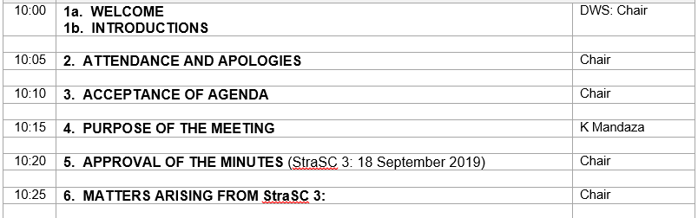
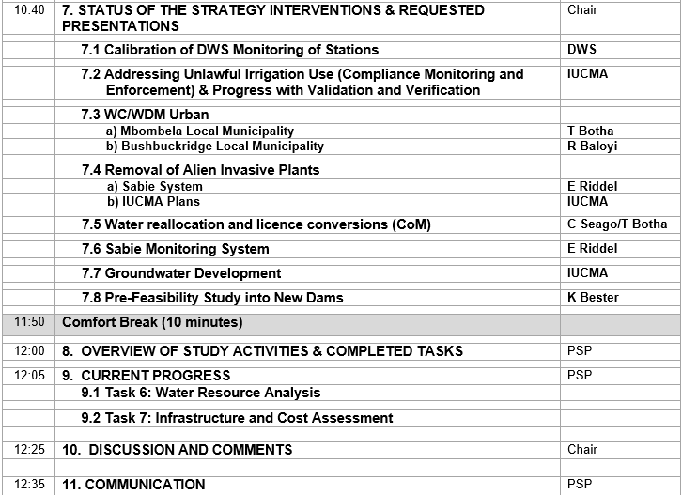
Agenda

Slide 4
CONTINUATION OF WATER REQUIREMENTS AND AVAILABILITY RECONCILIATION STRATEGY FOR THE MBOMBELA MUNICIPAL AREA (Crocodile Sabie River System Reconciliation Strategy) Strategy Steering Committee Meeting StraSC 4 Item 4: Purpose of the Meeting

Slide 5
Background to this Assignment
Reconciliation Strategy for the Mbombela Municipal area was developed (2014)
Recommends sequence of management and infrastructural interventions required to maintain acceptable assurances of supply to the users.

Slide 6
Outcomes of previous assignment
Options for reconciling increasing water requirements with the current supply in the Crocodile and Sabie Catchments included:
Water Conservation and Demand Management (WC/WDM)
Removal of Invasive Alien Plants (IAPs)
Reallocation of water (pending DWS approval)
System Operating Rules for Primkop Dam and other upstream dams (yield optimisation)
Groundwater development
Rain and fog harvesting

Slide 7
Outcomes of previous assignment
Regional Dam: 3 possible schemes were identified in the Crocodile River catchment:
Montrose Dam (eliminated – other options more economical)
Mountain View Dam (to be investigated further – feasibility study)
Strathmore off-channel storage dam (to be investigated further – feasibility study)
Please visit: http://www6.dwa.gov.za/iwrp/projects.aspx for all project related information

Slide 8
Why Continuation of a Strategy? (This Study)
Water balances need to be continuously monitored / investigated and the strategy regularly updated to remain technically relevant.
Ensures that intervention planning can be implemented taking into account any changes that may impact on the projected water balance.
Study Objective: In-depth review, systematically update and improve the water resource reconciliation strategy so that it remains relevant, technically sound, economically viable, socially acceptable and sustainable and thus enabling the implementation of the strategy by the relevant authorities.

Slide 9
Purpose of the Meeting
Overview of study activities since StraSC Meeting 3
Feedback on Strategy interventions

Slide 10
CONTINUATION OF WATER REQUIREMENTS AND AVAILABILITY RECONCILIATION STRATEGY FOR THE MBOMBELA MUNICIPAL AREA (Crocodile Sabie River System Reconciliation Strategy) Strategy Steering Committee Meeting StraSC 4 Items 5&6: Minutes and Matters Arising

Slide 11
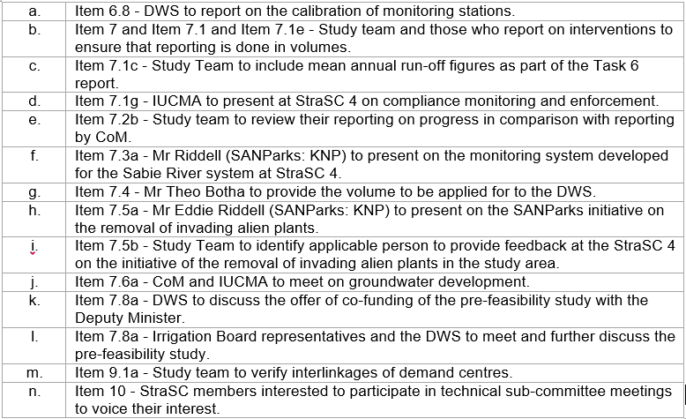
Matters Arising: Action list

Slide 12
CONTINUATION OF WATER REQUIREMENTS AND AVAILABILITY RECONCILIATION STRATEGY FOR THE MBOMBELA MUNICIPAL AREA (Crocodile Sabie River System Reconciliation Strategy) Strategy Steering Committee Meeting StraSC 4 Item 7: Status of Strategy (2014) Interventions

Slide 13
Intervention (from 2014 Strategy) | Representative Feedback
7.1 Calibration of DWS Monitoring of Stations | DWS
7.2 Addressing Unlawful Irrigation Use (Compliance Monitoring and Enforcement) & Progress with Validation and Verification | IUCMA
7.3 WC/WDM Urban
a) Mbombela Local Municipality | T Botha
b) Bushbuckridge Local Municipality | Chair/PSP
7.4 Removal of Alien Invasive Plants
a) Sabie System | E Riddel
b) IUCMA Plans | IUCMA
7.5 Water reallocation and licence conversions (CoM) | C Seago/T Botha
7.6 Sabie Monitoring System | E Riddel
7.7 Groundwater Development | IUCMA
7.8 Pre-Feasibility Study into New Dams | K Bester

Slide 14
DWS MONITORING STATIONS
Crocodile: H stations
X1H003 Komati @ Tonga
X1H016 Buffels @ Doornpoort
X1H017 Komati @ Waterval
X1H018 Komati @ Gemsbokhoek
X1H033 Komati @ Nooitgedacht dam
X1H036 Komati @ Vygeboom dam
X1H053 Komati @ Mweti
X2H005 Nels @ Boschrand
X2H006 Crocodile @ Karino
X2H008 Queens @ Sassenheim
X2H010 Noordkaap @ Belleview
X2H013 Crocodile @ Montrose
X2H014 Houtbosloop @ Sudwalaskraal
X2H015 Elands @ Lindenau
X2H016 Crocodile @ Tenbosch
X2H022 Kaap @ Dolton
X2H032 Crocodile @ Weltevrede
X2H036 Komati @ Komatipoort
X2H046 Crocodile @ Riverside
X2H059 Wit @ Goedehoop
X2H096 Crocodile @ New Montorose
X2H097 Crocodile @ Esselen
Crocodile: R stations
X1R001 Komati @ Nooigedact dam
X1R003 Komati @ Vygeboom dam
X1R004 Lomati @ Driekoppies dam
X2R005 Crocodile @ Kwena dam
Sabie/Sand: H stations
X3H001 Sabie @ Sabie
X3H002 Klein Sabie @ Sabie
X3H003 Mac Mac @ Geelhoutboom
X3H004 Noordsand @ De Rust
X3H008 Sand @ Exeter
X3H015 Sabie @ Lower Sabie
X3H021 Sabie @ Kruger Gate

Slide 15
Intervention (from 2014 Strategy) | Representative Feedback
7.1 Calibration of DWS Monitoring of Stations | DWS
7.2 Addressing Unlawful Irrigation Use (Compliance Monitoring and Enforcement) & Progress with Validation and Verification | IUCMA
7.3 WC/WDM Urban
a) Mbombela Local Municipality | T Botha
b) Bushbuckridge Local Municipality | Chair/PSP
7.4 Removal of Alien Invasive Plants
a) Sabie System | E Riddel
b) IUCMA Plans | IUCMA
7.5 Water reallocation and licence conversions (CoM) | C Seago/T Botha
7.6 Sabie Monitoring System | E Riddel
7.7 Groundwater Development | IUCMA
7.8 Pre-Feasibility Study into New Dams | K Bester

Slide 16
Intervention (from 2014 Strategy) | Representative Feedback
7.1 Calibration of DWS Monitoring of Stations | DWS
7.2 Addressing Unlawful Irrigation Use (Compliance Monitoring and Enforcement) & Progress with Validation and Verification | IUCMA
7.3 WC/WDM Urban
a) Mbombela Local Municipality | T Botha
b) Bushbuckridge Local Municipality | Chair/PSP
7.4 Removal of Alien Invasive Plants
a) Sabie System | E Riddel
b) IUCMA Plans | IUCMA
7.5 Water reallocation and licence conversions (CoM) | C Seago/T Botha
7.6 Sabie Monitoring System | E Riddel
7.7 Groundwater Development | IUCMA
7.8 Pre-Feasibility Study into New Dams | K Bester

Slide 17
Intervention (from 2014 Strategy) | Representative Feedback
7.1 Calibration of DWS Monitoring of Stations | DWS
7.2 Addressing Unlawful Irrigation Use (Compliance Monitoring and Enforcement) & Progress with Validation and Verification | IUCMA
7.3 WC/WDM Urban
a) Mbombela Local Municipality | T Botha
b) Bushbuckridge Local Municipality | Chair/PSP
7.4 Removal of Alien Invasive Plants
a) Sabie System | E Riddel
b) IUCMA Plans | IUCMA
7.5 Water reallocation and licence conversions (CoM) | C Seago/T Botha
7.6 Sabie Monitoring System | E Riddel
7.7 Groundwater Development | IUCMA
7.8 Pre-Feasibility Study into New Dams | K Bester

Slide 18
Intervention (from 2014 Strategy) | Representative Feedback
7.1 Calibration of DWS Monitoring of Stations | DWS
7.2 Addressing Unlawful Irrigation Use (Compliance Monitoring and Enforcement) & Progress with Validation and Verification | IUCMA
7.3 WC/WDM Urban
a) Mbombela Local Municipality | T Botha
b) Bushbuckridge Local Municipality | Chair/PSP
7.4 Removal of Alien Invasive Plants
a) Sabie System | E Riddel
b) IUCMA Plans | IUCMA
7.5 Water reallocation and licence conversions (CoM) | C Seago/T Botha
7.6 Sabie Monitoring System | E Riddel
7.7 Groundwater Development | IUCMA
7.8 Pre-Feasibility Study into New Dams | K Bester

Slide 19
7.5: City of Mbombela Allocations
Brief Assignment to determine and summarise the CoM allocations
Outcome to be compared with growing requirements and infrastructure capacities to determine where shortfalls occur
Approach: gather historical information from CoM and updated information from IUCMA

Slide 20
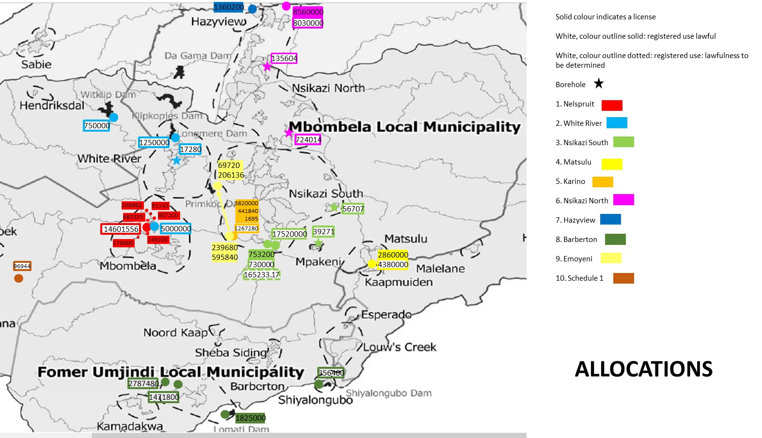
Way forward: IUCMA to arrange meeting with CoM and Suidkaap / Queensriver IB to discuss allocations and conversions

Slide 21
Intervention (from 2014 Strategy) | Representative Feedback
7.1 Calibration of DWS Monitoring of Stations | DWS
7.2 Addressing Unlawful Irrigation Use (Compliance Monitoring and Enforcement) & Progress with Validation and Verification | IUCMA
7.3 WC/WDM Urban
a) Mbombela Local Municipality | T Botha
b) Bushbuckridge Local Municipality | Chair/PSP
7.4 Removal of Alien Invasive Plants
a) Sabie System | E Riddel
b) IUCMA Plans | IUCMA
7.5 Water reallocation and licence conversions (CoM) | C Seago/T Botha
7.6 Sabie Monitoring System | E Riddel
7.7 Groundwater Development | IUCMA
7.8 Pre-Feasibility Study into New Dams | K Bester

Slide 22
Intervention (from 2014 Strategy) | Representative Feedback
7.1 Calibration of DWS Monitoring of Stations | DWS
7.2 Addressing Unlawful Irrigation Use (Compliance Monitoring and Enforcement) & Progress with Validation and Verification | IUCMA
7.3 WC/WDM Urban
a) Mbombela Local Municipality | T Botha
b) Bushbuckridge Local Municipality | Chair/PSP
7.4 Removal of Alien Invasive Plants
a) Sabie System | E Riddel
b) IUCMA Plans | IUCMA
7.5 Water reallocation and licence conversions (CoM) | C Seago/T Botha
7.6 Sabie Monitoring System | E Riddel
7.7 Groundwater Development | IUCMA
7.8 Pre-Feasibility Study into New Dams | K Bester

Slide 23
Intervention (from 2014 Strategy) | Representative Feedback
7.1 Calibration of DWS Monitoring of Stations | DWS
7.2 Addressing Unlawful Irrigation Use (Compliance Monitoring and Enforcement) & Progress with Validation and Verification | IUCMA
7.3 WC/WDM Urban
a) Mbombela Local Municipality | T Botha
b) Bushbuckridge Local Municipality | Chair/PSP
7.4 Removal of Alien Invasive Plants
a) Sabie System | E Riddel
b) IUCMA Plans | IUCMA
7.5 Water reallocation and licence conversions (CoM) | C Seago/T Botha
7.6 Sabie Monitoring System | E Riddel
7.7 Groundwater Development | IUCMA
7.8 Pre-Feasibility Study into New Dams | K Bester

Slide 24
CONTINUATION OF WATER REQUIREMENTS AND AVAILABILITY RECONCILIATION STRATEGY FOR THE MBOMBELA MUNICIPAL AREA (Crocodile Sabie River System Reconciliation Strategy) Strategy Steering Committee Meeting StraSC 4 Item 8: Overview of Study Activities

Slide 25
STUDY TASKS
TASK NUMBER | TASK DESCRIPTIONS
1 | Inception and Literature Review
2 | Economic Growth and Demographic Analysis
3 | Water Requirements and Return Flows
4 | Water Conservation and Demand Management
5 | Monitoring Network Expansion and Data Capturing
6 | Water Resources Analysis
7 | Infrastructure and Cost Assessment
8 | Preliminary and Updated Reconciliation Strategy
9 | Ad Hoc Support
10 | Capacity Building and Training
11 | Stakeholder Engagement
12 | Study Reports
13 | Study Management

Slide 26
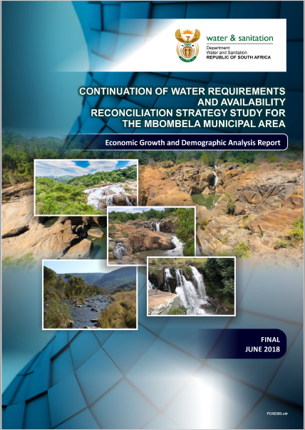
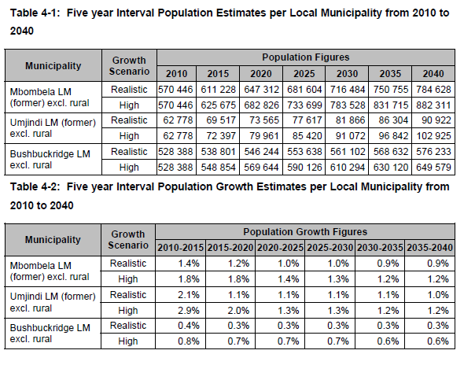

Slide 27
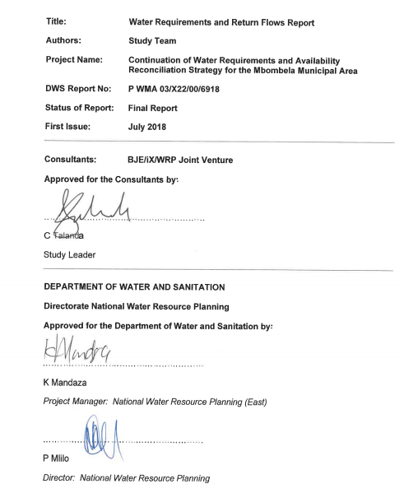
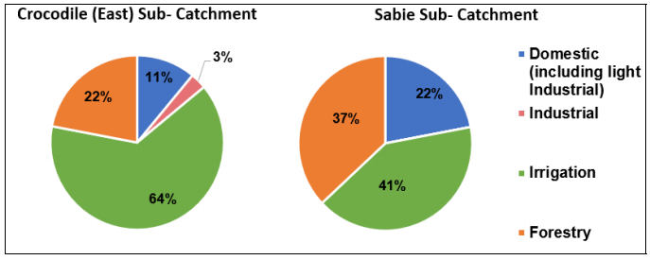

Slide 28
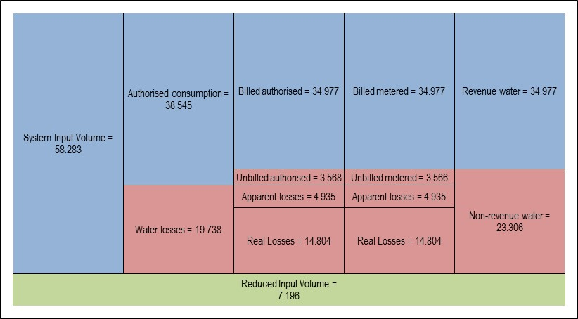
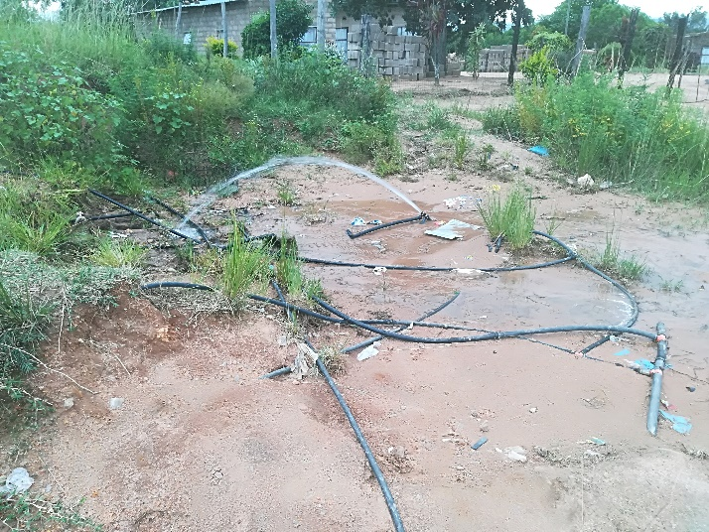
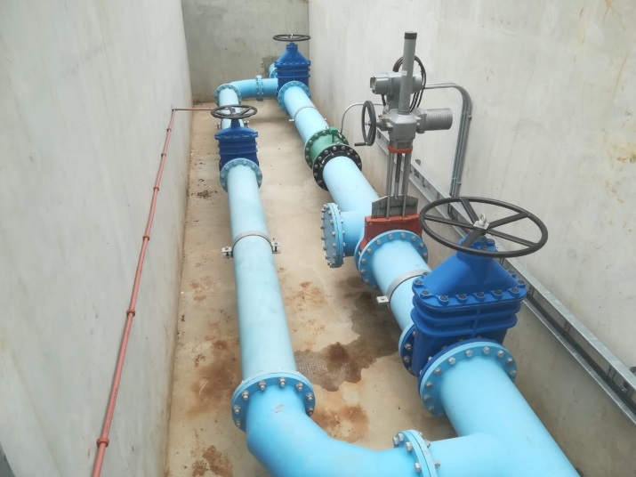
Target (realistic) savings from WCWDM:
CoM: 10%
BBR: 15%

Slide 29
CONTINUATION OF WATER REQUIREMENTS AND AVAILABILITY RECONCILIATION STRATEGY FOR THE MBOMBELA MUNICIPAL AREA (Crocodile Sabie River System Reconciliation Strategy) Strategy Steering Committee Meeting StraSC 4 Item 9: Current Progress

Slide 30
CONTINUATION OF WATER REQUIREMENTS AND AVAILABILITY RECONCILIATION STRATEGY FOR THE MBOMBELA MUNICIPAL AREA (Crocodile Sabie River System Reconciliation Strategy) Strategy Steering Committee Meeting StraSC 4 Item 9.1: Water Resources Assessment

Slide 31
9.1: TASK 7: Water Resources
Hydrology, system yields, water resource model configuration
Previous Water Resources Studies:
DWS: Inkomati Water Availability Assessment (2009)
DWS: IWAAS Maintenance (2012)
DWS: Classification Study (2013)
DWS: Reconciliation Strategy Study (2014)
IUCMA: Operational Support (ongoing)
IUCMA: Hydrology updates: Croc East (2019)
Water Resources Summary, Mbombela Recon Strategy (2014)
Water reconciliation strategy update for the schemes in the Sabie and Sand river system Bushbuckridge Local Municipality (2016)

Slide 32
Hydrology
IWAAS
Major study, detailed landuse evaluation, external review
WRYM configured, yields produced
IWAAS Maintenance
Small adjustments to hydrology in some catchments due to evaporation error
IUCMA update: Crocodile East, timing did not allow for incorporation into this study, incorporate into future Strategy Update
 | 1920-2004 | 1920-2016
Tertiary | IWAAS Maint. | Update (2019)
X21 | 467.3 | 493.8
X22 | 381.9 | 394.7
X23 | 195.4 | 210.5
X24 | 106.6 | 112.0
Total | 1151.1 | 1211.0

Slide 33
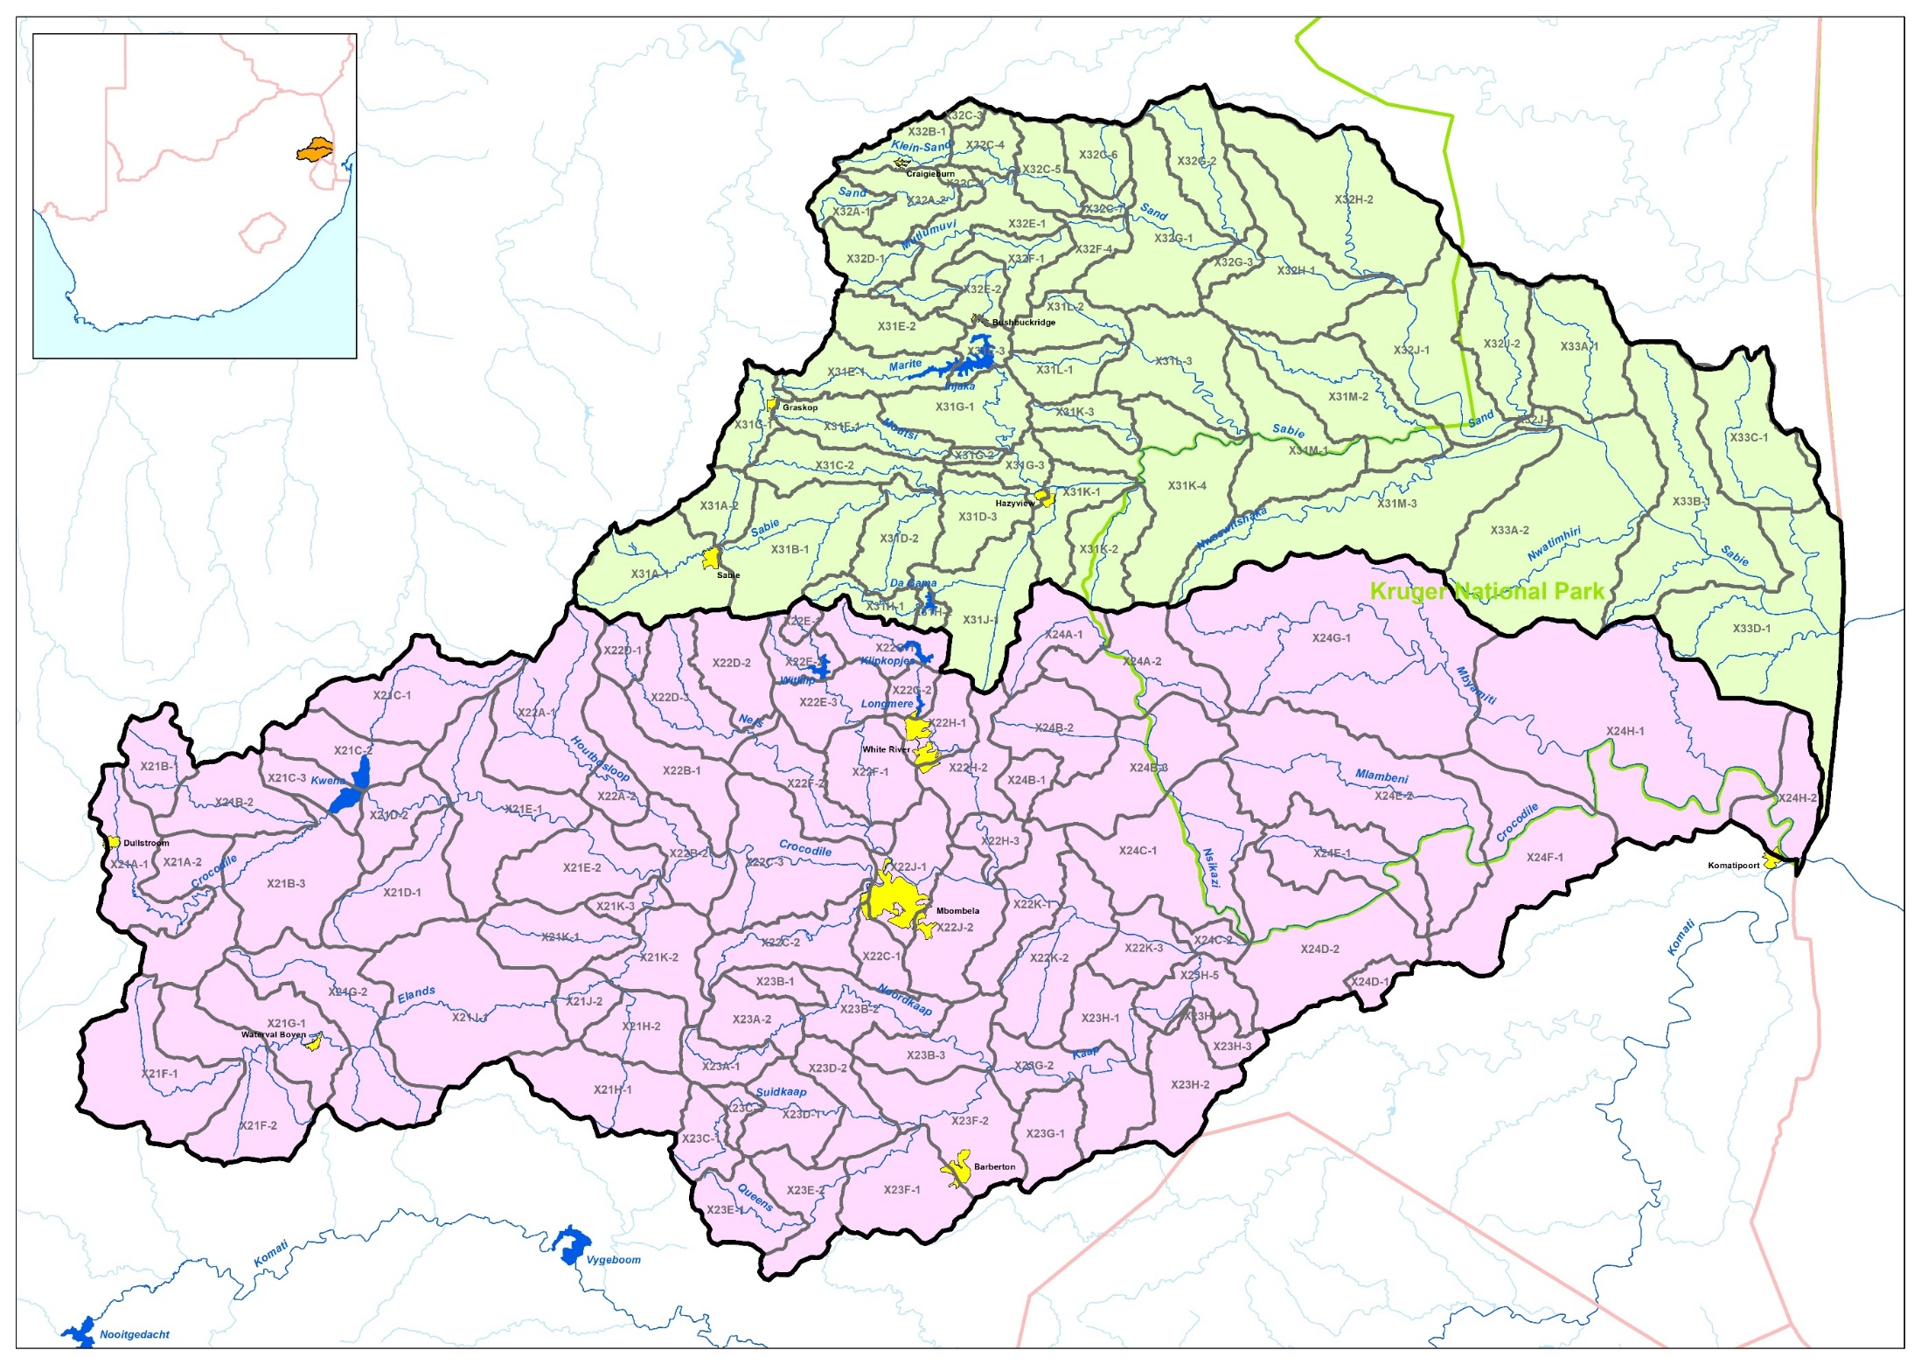
140 Sub-catchments

Slide 34
Model Updates / Enhancements
IWAAS WRYM used as base
2 individual model configurations (1 Sabie/Sand, 1 Crocodile East)
Landuse remains as per IWAAS (Agreed in Water Requirements Task of Study)
Combination into 1 WRPM configuration to assess future growth in water requirements and integrated WRM
Incorporation of Demand Centres
Incorporation of Irrigation
Incorporation of EWRs
Configuration of operating rules

Slide 35
Operating Rules (supplied by IUCMA)
Catch-ment | Dam trigger | Dam level % | Restriction % | Supply factor | Sector
Croc | Kwena | 70 | 35 | 0.65 | Irrig
 |  | 55 | 60 | 0.4
 |  | 10 | 100 | 0
 |  | 60 | 10 | 0.9 | Dom
 |  | 40 | 20 | 0.8
 |  | 20 | 30 | 0.7
 |  | 10 | 10 | 0.9 | Ind
Sabie | Inyaka | 65 | 40 | 0.6 | Irrig
 |  | 20 | 60 | 0.4
 |  | 60 | 10 | 0.9 | Dom
 |  | 40 | 20 | 0.8
 |  | 20 | 30 | 0.7

Slide 36
METHODOLOGY TO UNDERTAKE WATER RESOURCES ANALYSES
Water resources yield model (WRYM)
Historic firm yields
Stochastic yields (Long term and Short term)
WATER RESOURCES PLANNING MODEL (WRPM)
Risk based analyses
Assessment of current operating rules
Analysis of alternative operating rule
Assessments based on assurance of supply

Slide 37
YIELD MODELLING: VARYING APPROACHES
White river
Witklip Dam
Klipkopje, Longmere, Primkop Dams
Crocodile RIVER
Kwena Dam
Systems yield
SABIE RIVER
Inyaka Dam
NEW DAMS
Mountain View, Boschjeskop
New Forest, Dingleydale

Slide 38
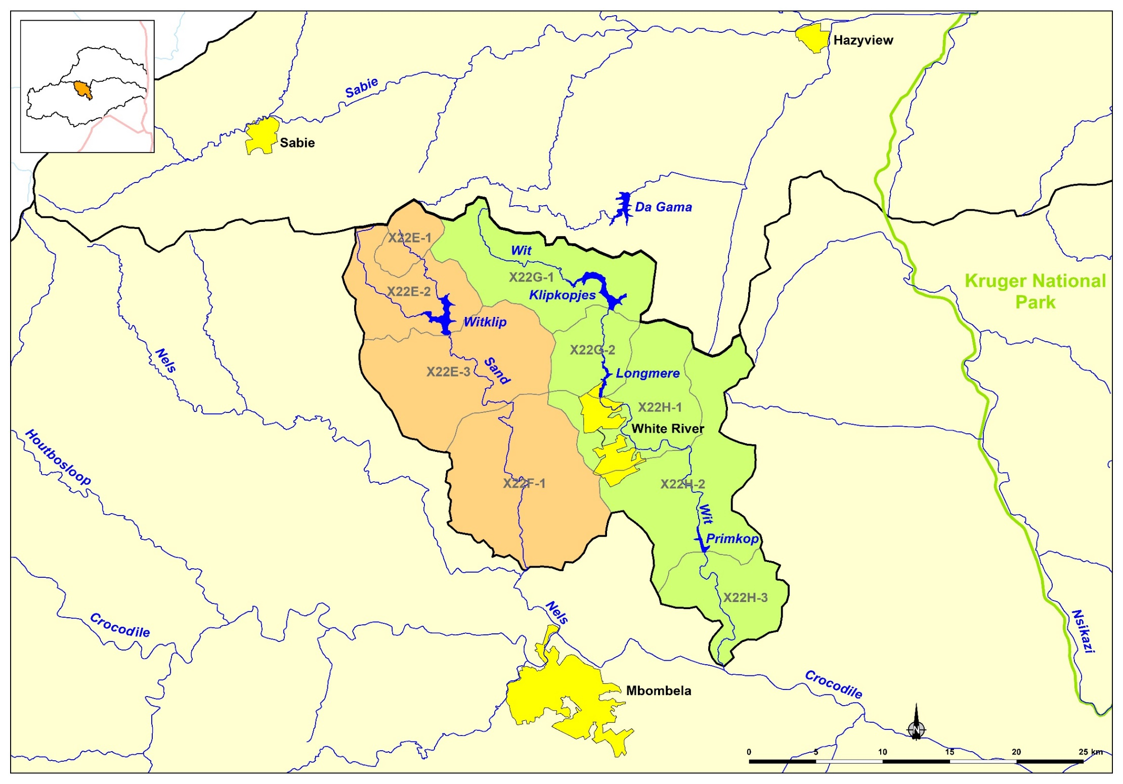
WHITE RIVER
Yield
Yield

Slide 39
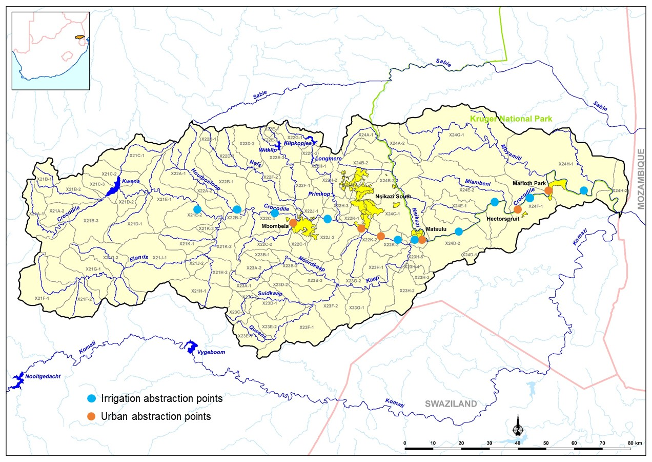
CROCODILE
Yield
Yield

Slide 40
SABIE
Yield

Slide 41
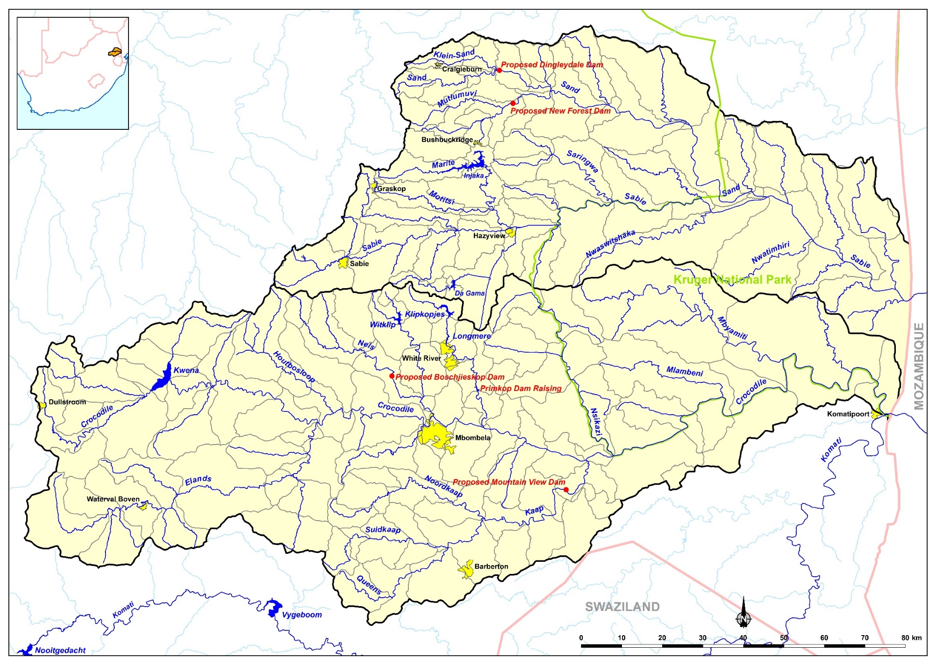
PROPOSED DAMS/OPTIONS

Slide 42
Historic firm yields and current demands
Dam/System | Historic Firm Yield (million m³/annum) | Current demand (million m³/annum)
Witklip Dam | 8.1 | 0.31 White River WTW 10.8 Irrigation 11.11 Total
Klipkopje, Longmere, Primkop Dams | 14.0 | 1.61 White River (LM) 0.32 Emoyeni (Primkop) 12.4 Irrigation 14.33 Total

Slide 43
Historic firm yields and current demands
Dam/System | Historic Firm Yield (million m³/annum)
Kwena Dam | 49.5
Crocodile System | 186.7
 | Current demand (million m³/annum)
Crocodile Irrigation Board | 304.0
City of Mbombela for Nelspruit, including Rocky Drift | 17.50
City of Mbombela for Emoyeni from Crocodile and Karino | 0.95
City of Mbombela for Nsikazi South | 25.40
City of Mbombela for Matsulu | 6.26
Malelane | 0.75
Hectorsspruit | 0.22
Marloth Park | 0.95
Total | 356.03

Slide 44
Historic firm yields and current demands
Dam/System | Historic Firm Yield (million m³/annum)
Inyaka Dam | 21.3
User | Current demand (million m³/annum)
Acornhoek and Thulamahashe | 25.0
Marite | 3.50
Hoxani | 14.45
Nsikazi North, (City of Mbombela) | 10.62
Hazyview | 1.69
Lawful Allocations in X31G, Marite | 14.12
Total | 69.4

Slide 45
Historic firm yields
Dam/System | Historic Firm Yield (million m³/annum)
Potential Boschjeskop | 31.2
Potential Mountain View | 78.1
Potential Dingleydale | 20.6
Potential New Forest | 19.6
Raise Primkop to 8 million m³ | 1.2
Raise Primkop to 30 million m³ | 5.9

Slide 46
Typical Urban criteria
98% assurance of supply
=
2% risk of non-supply
=
1 in 50 year recurrence interval

Slide 47
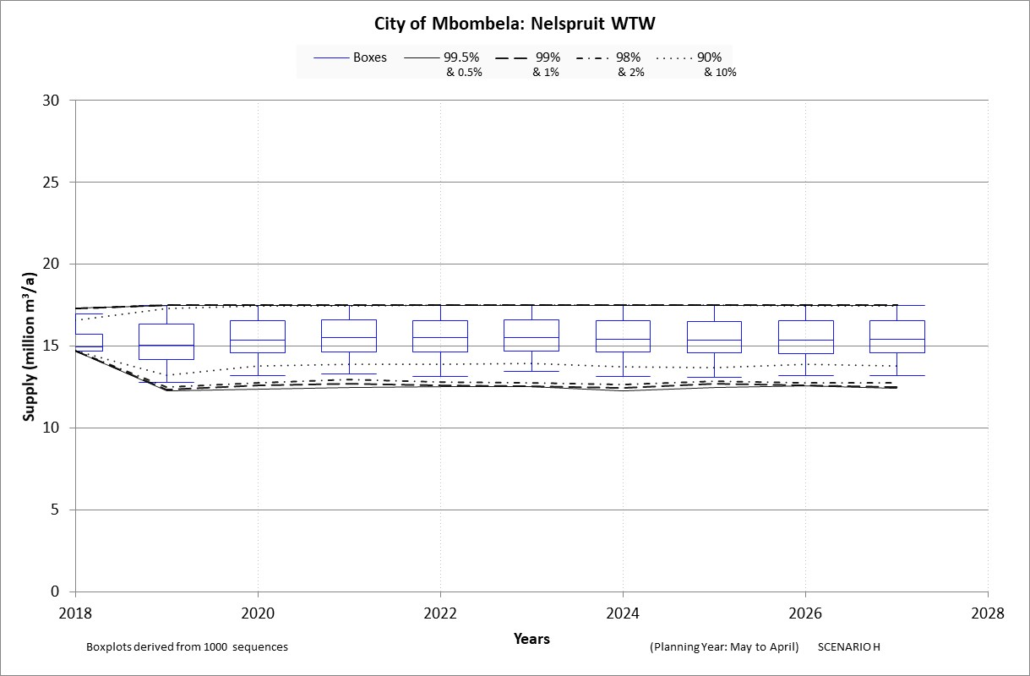
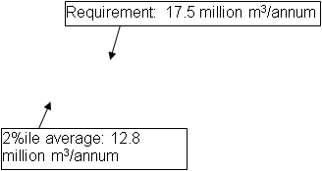
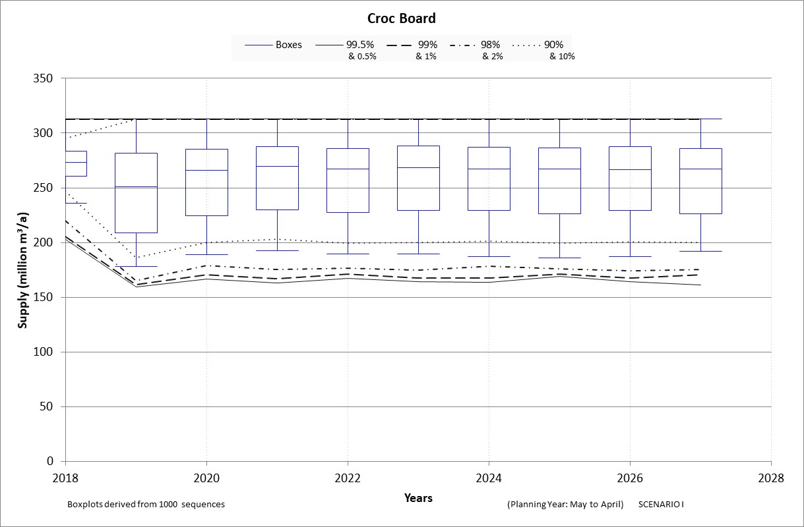
Current operating rule
Average supply: 259 million m³/annum

Slide 48
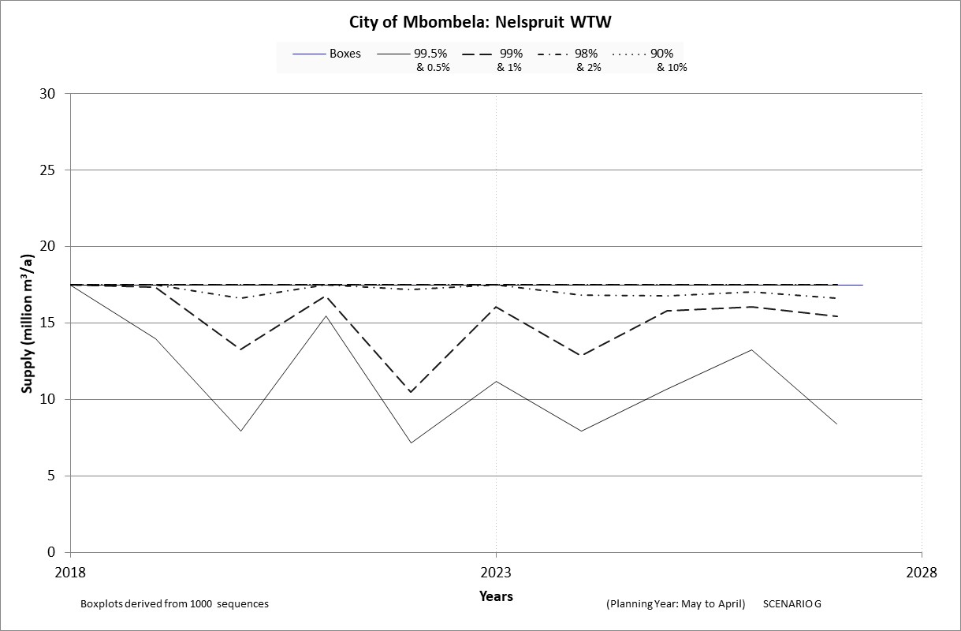
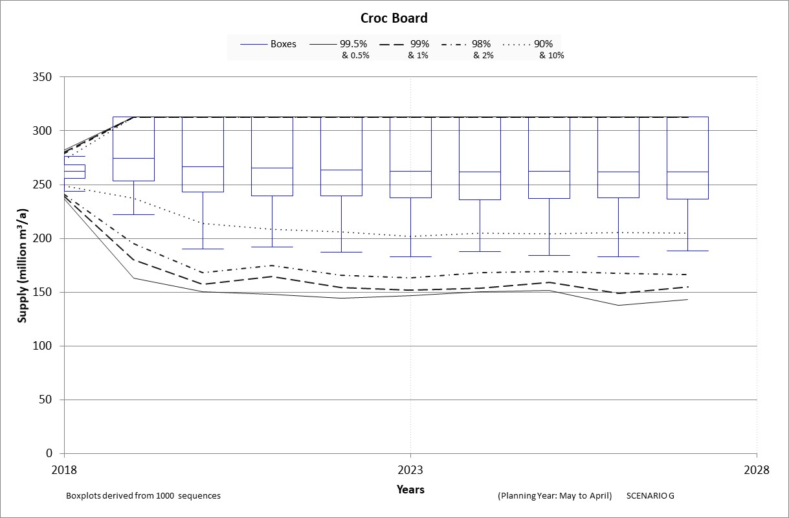
Alternative operating rule (dynamic driven by short term curves)
98%ile
Average supply: 266 million m³/annum

Slide 49
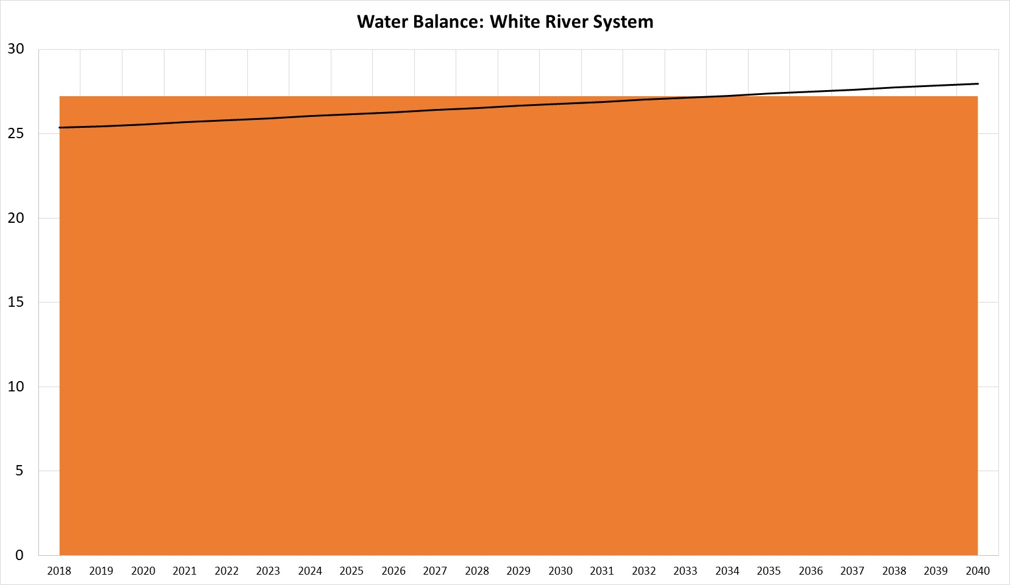
Current system balances
Demand projection
Long Term Yield: 27.2 million m³/annum

Slide 50
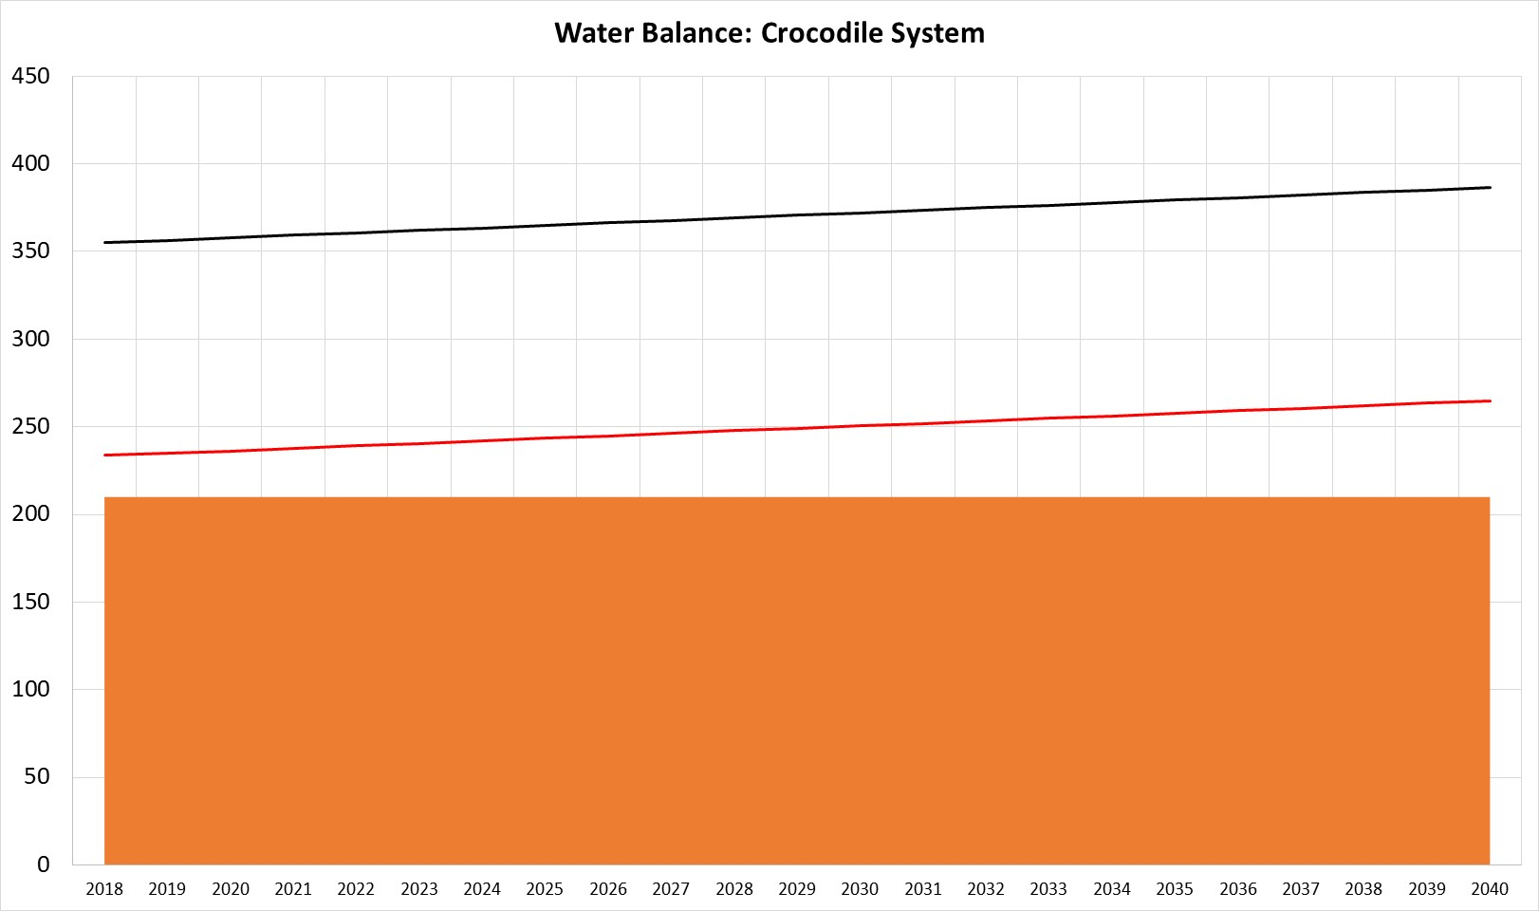
Current system balances
Demand projection (irrigation = allocation)
Demand projection (irrigation 60% of allocation)
Long Term Yield: 75% assurance: 210 million m³/annum

Slide 51
Current system balances
Demand projection
Long Term Yield: 98% assurance: 24.2 million m³/annum

Slide 52
Summary of WRPM Results
Crocodile system:
White River should be operated separately, should make some releases to contribute to Crocodile EWR
Current resources insufficient to supply existing users at required level of assurance
Operation should be adjusted to protect higher priority users (urban), rules should be dynamic and reassessed each year (Annual analyses)
Continuation of “hands on” operation to extract most from the system

Slide 53
Summary of WRPM Results
Sabie Sand system:
Current resources insufficient to supply existing users including Environmental releases
System requires urgent intervention to supply existing users as well as future growth.

Slide 54
Summary and Way forward
Water resources analyses results to be used in preparation of the Strategy water balances and proposed intervention measures
Based on results recommendations will be to fast track intervention measures in order to obtain a system balance

Slide 55
CONTINUATION OF WATER REQUIREMENTS AND AVAILABILITY RECONCILIATION STRATEGY FOR THE MBOMBELA MUNICIPAL AREA (Crocodile Sabie River System Reconciliation Strategy) Strategy Steering Committee Meeting StraSC 4 Item 9.2: Infrastructure and Cost Assessment

Slide 56
task 7: INFRASTRUCTURE AND COST ASSESSMENT Task 7 relates to the infrastructure of the intervention options identified during the previous Reconciliation Strategy, including the related financial implications. The Task has been divided into subtasks with deliverables: Task 7: Infrastructure and Cost Assessment Report (Report 6) Task 7.1: Infrastructure/Intervention Status Quo Module Chapter in the Infrastructure and Cost Assessment Report (Report 6) Completed Task 7.2: Options Development Module Chapter in the Infrastructure and Cost Assessment Report (Report 6)

Slide 57
Deliverable 7.2: Options Development Module
The purpose of this module is the following:
Identification of potential interventions (long list) to augment the water supply.
Selection of potential interventions (short list) for further evaluation.
Descriptions of the features of the selected potential interventions.
Reviewing previous designs/concepts of the selected potential interventions.
Reviewing and updating cost estimates of the selected potential interventions.
Engineering economic analyses of the selected potential interventions and assessing life cycle costs.

Slide 58
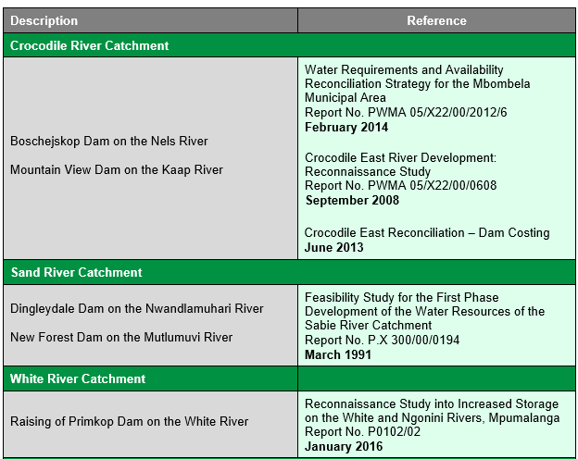
Summary of Selected Interventions

Slide 59
Selected Interventions: Regional Schemes (Dams)
Proposed Dams:
Crocodile Catchment
Boschejskop Dam on the Nels River
Mountain View Dam on the Kaap River
Sand River Catchment
New Forest Dam on the Mutlumuvi River
Dingleydale Dam on the Nwandlamuhari River
White River Catchment
Raising of Primkop Dam on the White River

Slide 60
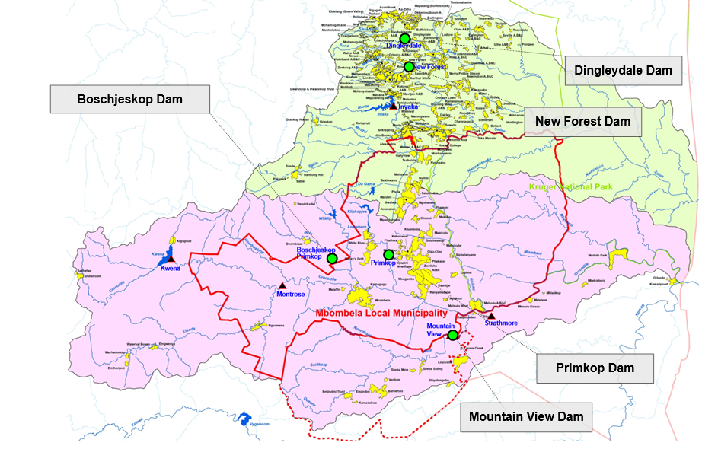
Locations of Potential Dams

Slide 61
Selected Interventions: Regional Schemes (Dams)
Dam Information:
Crocodile Catchment
Boschejskop Dam on the Nels River
Maximum Dam Height: 50 m
Full Supply Capacity: 130.5 million m³
Historic Firm Yield: 31.2 million m³/a
Mountain View Dam on the Kaap River
Maximum Dam Height: 74 m
Full Supply Capacity: 184.8 million m³
Historic Firm Yield: 78.1 million m³/a

Slide 62
Selected Interventions: Regional Schemes (Dams)
Dam Information:
Sand River Catchment
Dingleydale Dam on the Nwandlamuhari River
Maximum Dam Height: 35 m
Full Supply Capacity: 62.5 million m³
Historic Firm Yield: 20.6 million m³/a
New Forest Dam on the Mutlumuvi River
Maximum Dam Height: 42.2 m
Full Supply Capacity: 82 million m³
Historic Firm Yield: 19.6 million m³/a

Slide 63
Selected Interventions: Regional Schemes (Dams)
Dam Information:
White River Catchment
Raising of Primkop Dam on the White River
Maximum Dam Height: 17.5 m
Full Supply Capacity: 2 million m³
Historic Firm Yield: 3.4 million m³/a
An investigation funded by the City of Mbombela (CoM) confirmed the technical feasibility to raise the Primkop Dam wall.
A Terms of Reference for the Feasibility Study was issued in late 2019.
This Study needs to be updated with the results of the Feasibility Study into the raising of Primkop Dam.

Slide 64
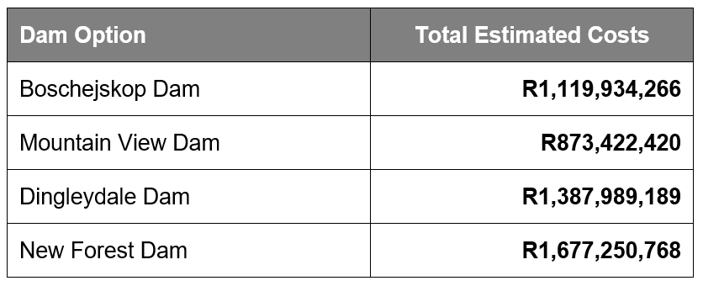
Selected Interventions: Regional Schemes (Dams)
Cost Estimates (Base Date January 2020):
Total capital costs at January 2020 rates, including miscellaneous, preliminaries and general (P&G), contingencies and design fees, but excluding VAT, Operation and Maintenance Costs, as well as energy (pumping) costs.

Slide 65
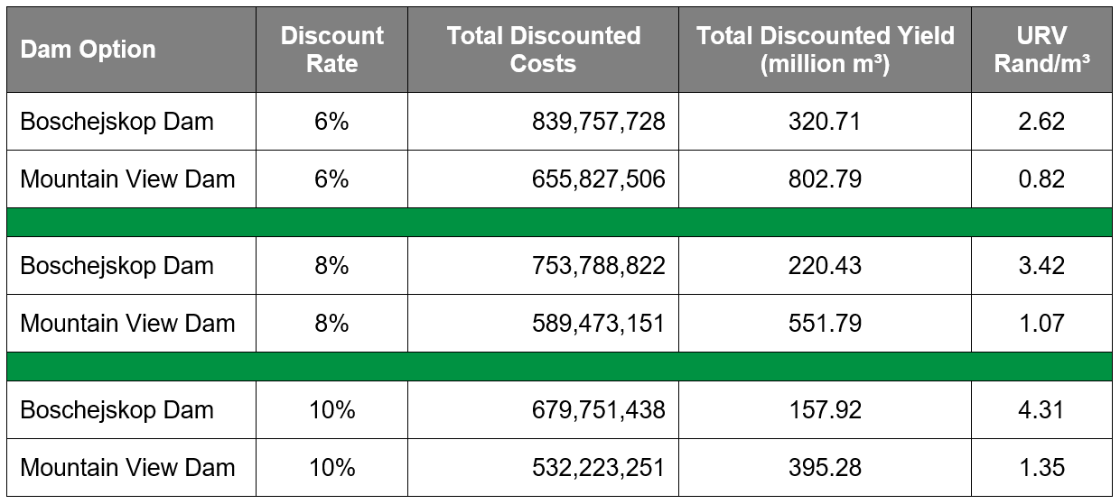
Selected Interventions: Regional Schemes (Dams)
Unit Reference Values (for a 45 year period from completion of construction)
Crocodile River Catchment
Mountain View Dam URV’S significantly lower than Boschejskop Dam.
Yield of Mountain View Dam (78.1 million m³/a) is more than double that of the Boschejskop Dam (32.1 million m³/a).
URV’s do not include energy (pumping) costs.

Slide 66
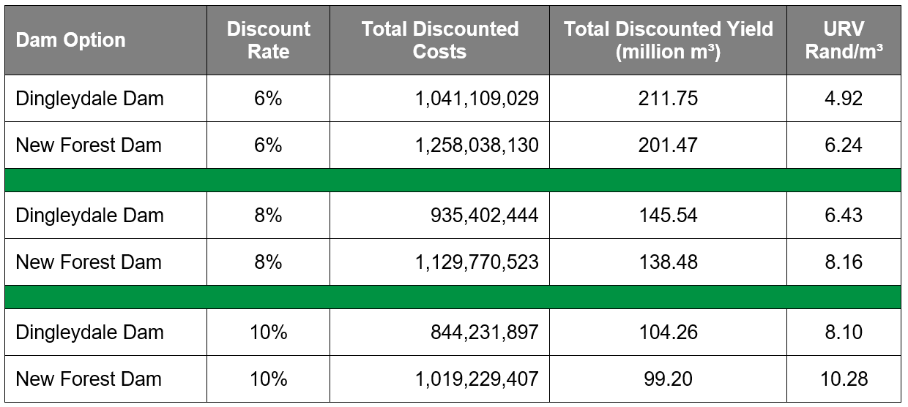
Selected Interventions: Regional Schemes (Dams)
Unit Reference Values (for a 45 year period from completion of construction)
Sand River Catchment
Dingleydale Dam lowest URV’S.
Yields of both dams are relatively low, Dingleydale Dam (20.6 million m³/a and New Forest Dam 19.6 million m³/a).
High URV’s.
URV’s do not include energy (pumping) costs.

Slide 67
Questions?

Slide 68
CONTINUATION OF WATER REQUIREMENTS AND AVAILABILITY RECONCILIATION STRATEGY FOR THE MBOMBELA MUNICIPAL AREA (Crocodile Sabie River System Reconciliation Strategy) Strategy Steering Committee Meeting StraSC 4 Item 10: Discussion and Comments

